Slide 1
Data Communication and Networking Course Code : CS44 Credits : 3:0:0
Nandini S B
Department of Computer Science and Engineering RIT, Bangalore

Slide 2
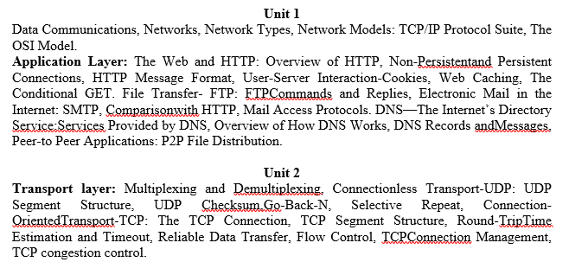
Syllabus

Slide 3
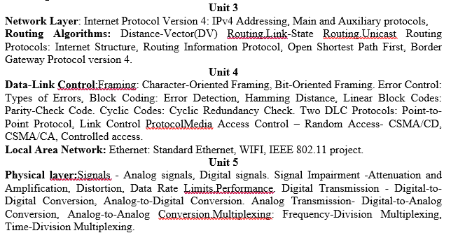

Slide 4
Books
Text Books:
Data Communications and Networking with TCP/IP Protocol Suite, Behrouz A. Forouzan, McGraw Hill, 6th Edition, 2021. : A Top-Down Approach, 8th edition, Addison-Wesley, 2021.
James F. Kurose and Keith W. Ross: Computer Networking
Notes:
Text Books:
1. Data Communication and Networking, Behrouz A.Forouzan, McGraw Hill, 5th Edition, 2008.
2. James F. Kurose and Keith W. Ross: Computer Networking: A Top-Down Approach, 6th edition, Addison-Wesley, 2013.
3. Forouzan: Data Communications and Networking, 5th edition, McGraw Hill Education 2013.
Reference Books:
1. Data and Computer Communication, William Stallings, 8th Edition, Pearson Education, 2007.
2. Introduction to Data Communications and Networking – Wayne Tomasi, Pearson Education, 2005.
3. Larry L. Peterson and Bruce S Davie: Computer Networks: A Systems Approach, Fifth Edition, Elsevier, 2011.
4. Tanenbaum: Computer Networks, 4th Ed, Pearson Education/PHI, 2003.
5. William Stallings: Data and Computer Communications, 8th Edition, Pearson Education, 2012.

Slide 5
Reference Books:
Data and Computer Communication, William Stallings, 10th Edition, Pearson Education, 2017.
Larry L. Peterson and Bruce S Davie: Computer Networks: A Systems Approach, Fifth Edition, Elsevier, 2011.
Tanenbaum: Computer Networks, 4th Ed, Pearson Education/PHI, 2018.

Slide 6
Course Outcomes:
At the end of the course, you will be able to:
Describe the various application layer protocols used by TCP/IP reference model. (PO-1, 2, 3, 4,10, PSO1).
Differentiate between connection oriented and connection less services of transport layer (PO-1, 2, 3, 4,10, PSO1).
Solve problems of IP addressing and routing using various routing protocols and algorithms. (PO-1, 2, 3, 4,10, PSO1).
Illustrate error control and media access control protocols of data link layer (PO-1, 2, 3, 4,10, PSO1).
Discuss different types of data transmission techniques. (PO-1, 2, 3, 4,10, PSO1).

Slide 7
Unit 1
DATA COMMUNICATIONS
NETWORKS
NETWORK TYPES
TCP/IP PROTOCOL SUITE
THE OSI MODEL
Application Layer

Slide 8
Data Communication
Communication : Sending or receiving message.
Data : information.
Sharing information :
Local → Face to Face
Remote → Over a distance

Slide 9
Data communications : Data communications is the exchange of data between two devices via some form of transmission medium such as a wire cable.
Telecommunications (tele is Greek for “far”)
Communication over a distance by definition
All type of communications using signaling such as voice (telephone), images (television), data (computers).

Slide 10
The effectiveness of a data communications system depends on four fundamental characteristics:
Delivery: deliver data to the correct destination
Accuracy: deliver the data accurately
Timeliness: deliver data in a timely manner
Jitter: the variation in the packet arrival time

Slide 11
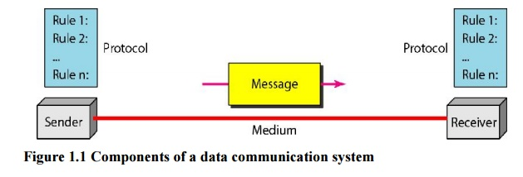
Components:

Slide 12
Message. The message is the information (data) to be communicated. Popular forms of information include text, numbers, pictures, audio, and video.
Sender. The sender is the device that sends the data message. It can be a computer, a telephone handset, a video camera, and so on.
Receiver. The receiver is the device that receives the message. It can be a computer, workstation, telephone handset, television, and so on.
Transmission medium. The transmission medium is the physical path by which a message travels from sender to receiver. Some examples of transmission media include twisted-pair wire, coaxial cable, fiber-optic cable, and radio waves.
Protocol. A protocol is a set of rules that govern data communications. It represents an agreement between the communicating devices. Without a protocol, two devices may be connected but not able to communicate, just as a person speaking French cannot be understood by a person who speaks only Japanese.

Slide 13
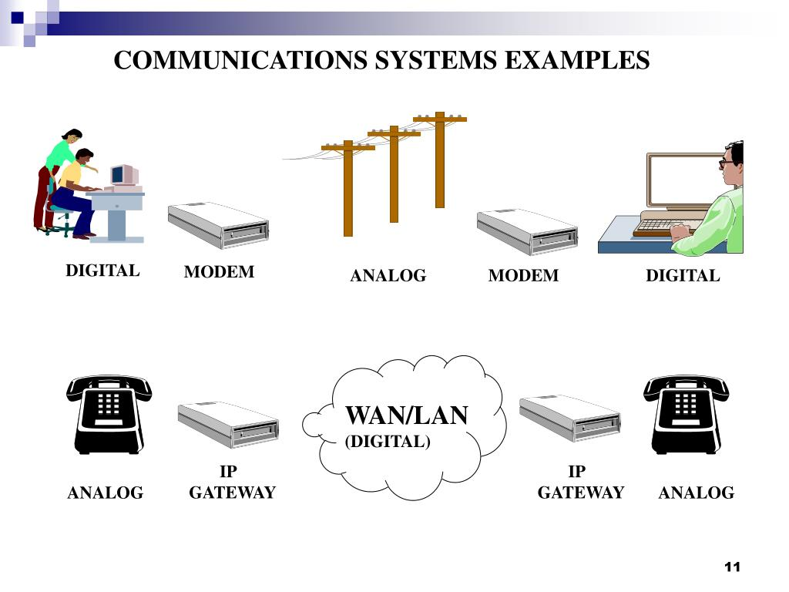

Slide 14
Message:
Text : In data communications, text is represented as a bit pattern, a sequence of bits (0s or 1s).
Numbers : Numbers are also represented by bit patterns.
Images : Images are also represented by bit patterns. In its simplest form, an image is composed of a matrix of pixels (picture elements), where each pixel is a small dot.
Audio : Audio refers to the recording or broadcasting of sound or music.
Video : Video refers to the recording or broadcasting of a picture or movie.

Slide 15
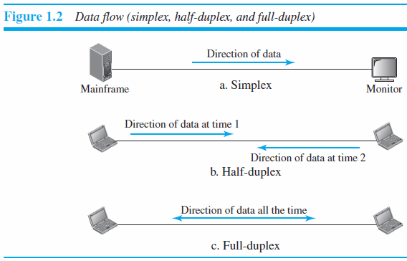
Data Flow :

Slide 16
Simplex : In simplex mode, the communication is unidirectional. Example : Keyboard and Monitor.
Half-Duplex : In half-duplex mode, each station can both transmit and receive, but not at the same time. Example : Walkie-talkies.
Full-Duplex : In full-duplex mode, both stations can transmit and receive simultaneously. Example : telephone network.

Slide 17
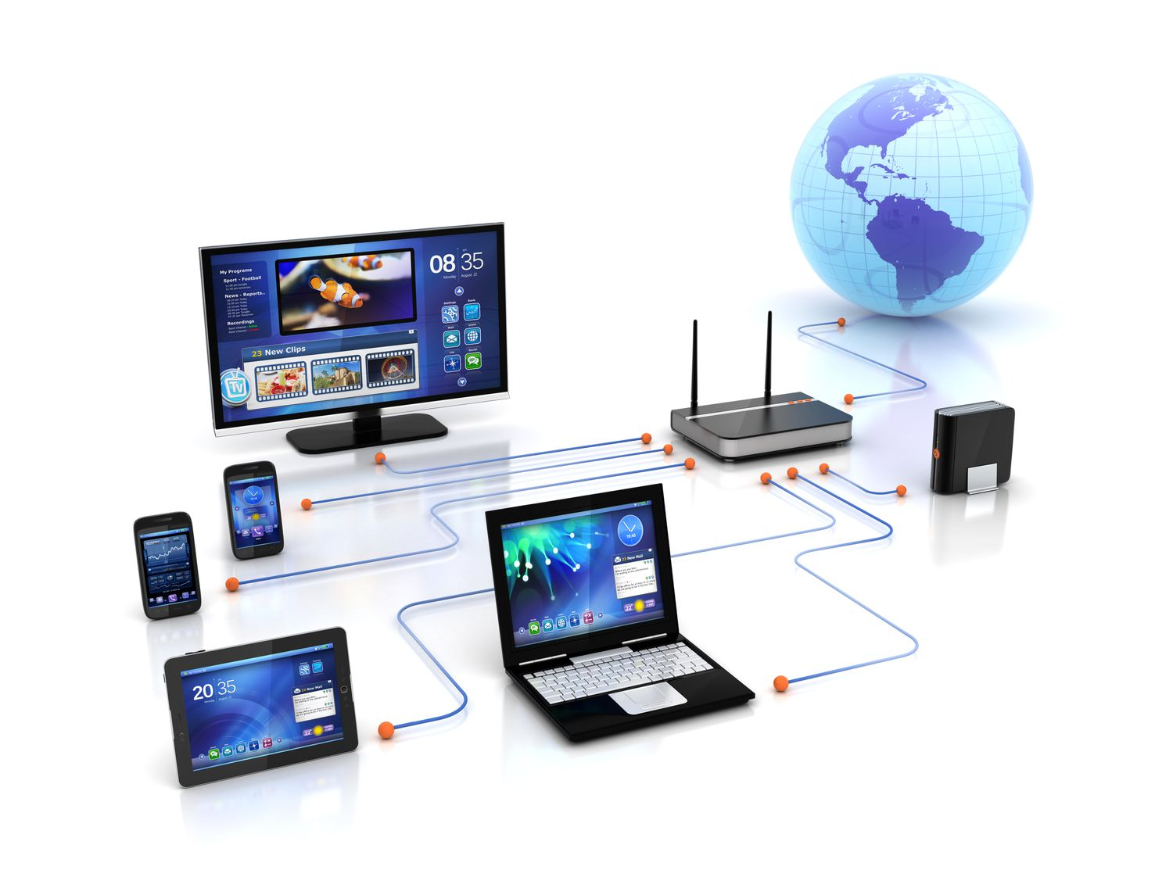
Networks
A network is a set of devices (nodes) connected by communication links.
A node can be a computer, printer, or any other device capable of sending and/or receiving data generated by other nodes on the network.

Slide 18
Distributed Processing : A task is divided among multiple computers.
Network Criteria : A network must be able to meet a certain number of criteria.
The most important of these are
Performance
reliability, and
security.

Slide 19
1. Performance:
Performance can be measured in many ways, including transit time and response time.
depends on a number of factors
the number of users
the type of transmission medium
the capabilities of the connected hardware
the efficiency of the software
Performance is often evaluated by two networking metrics: throughput and delay.

Slide 20
2. Reliability:
network reliability is measured by the frequency of failure,
the time it takes a link to recover from a failure, and
the network's robustness in a catastrophe
3. Security :
Network security issues include protecting data from unauthorized access.
protecting data from damage and development, and
Implementing policies and procedures for recovery from breaches and data losses.

Slide 21
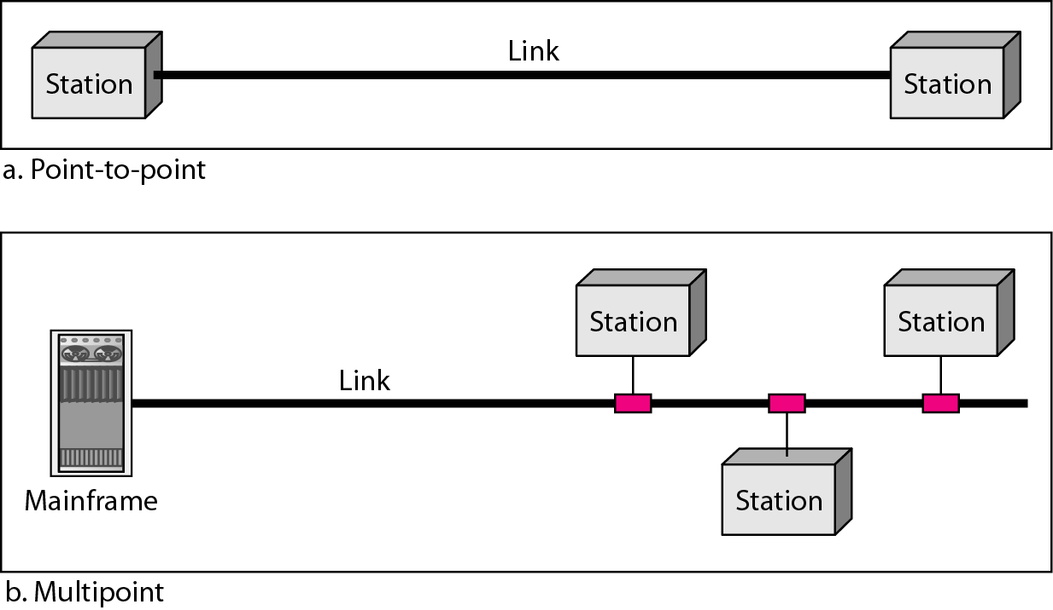
Physical Structures :
Type of Connection
A network is two or more devices connected through links.
There are two possible types of connections: point-to-point and multipoint.

Slide 22
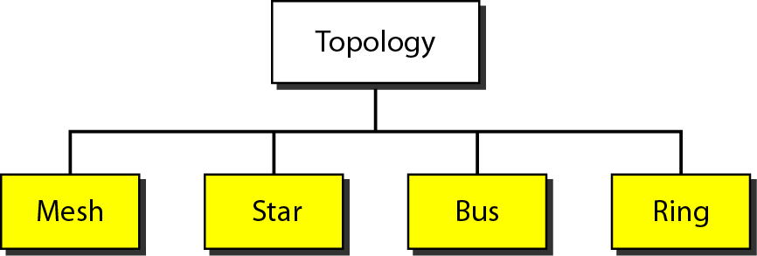
Physical Topology :
The topology of a network is the geometric representation of the relationship of all the links and linking devices (usually called nodes) to one another.
Common Network
Topologies

Slide 23
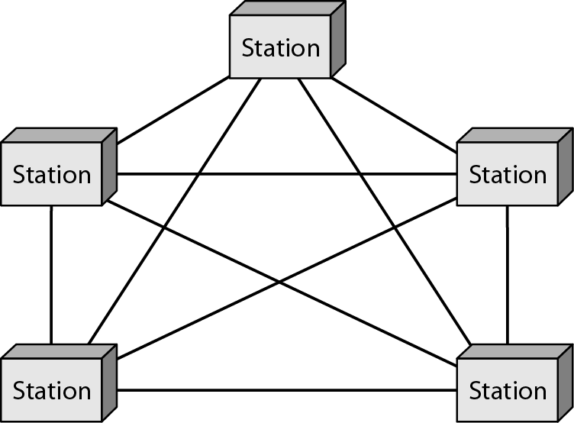
Mesh Topology :
Every device has a dedicated point-to-point link to every other device.
Number of physical links in a fully connected mesh network with n nodes : n (n – 1) physical links or n (n – 1) / 2 duplex-mode links.

Slide 24
Advantages
They use the dedicated links so each link can only carry its own data load – traffic problem can be avoided
It is robust – if one link get damaged, it cannot affect others
It gives privacy and security (message travels along a dedicated link)
Fault identification and fault isolation are easy
Disadvantages
The amount of cabling and the number of I/O ports required are very large.
because every device must be connected to every other device, installation and reconnection are difficult
The sheer bulk of wiring is larger than the available space
Hardware required to connect each device is highly expensive.

Slide 25
Applications
connection of telephone regional offices - each regional office needs to be connected to every other regional office
WAN – wide area network

Slide 26
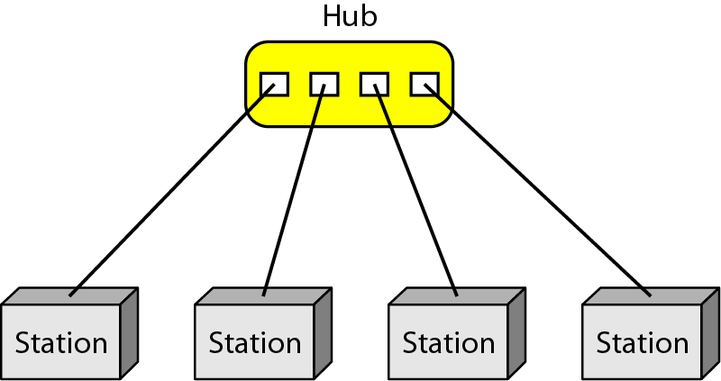
Star Topology :
Each device has a dedicated point to point link to the central controller called “Hub” – act as a exchange

Slide 27
Advantages
Less expensive than mesh since each device is connected only to the hub.
Robustness - if one link fails only that link is affected – all other links remain active
No disruptions to the network when connecting or removing the devices
Disadvantage
dependency of the whole topology on one single point, the hub. If the hub goes down, the whole system is dead
often more cabling is required in a star than in some other topologies (such as ring or bus).
Applications
local-area networks (LANs)
High-speed LANs

Slide 28
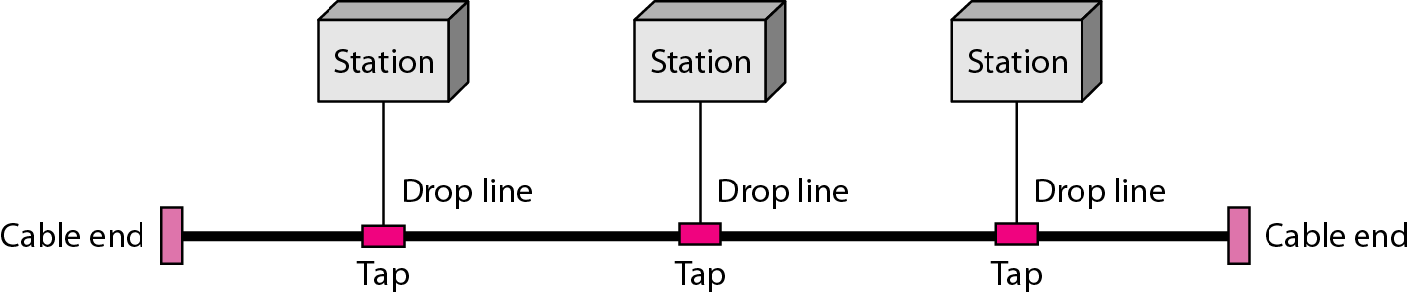
Bus Topology – multipoint
One long cable acts as a backbone to link all the devices in a network
Nodes are connected to the bus cable by drop lines and taps
drop line - a connection running between the device and the main cable
tap – splitter that cut the main link to create a contact with the metallic core
Allows only one device to transmit at a time

Slide 29
Advantages
ease of installation
less cabling than mesh or star topologies
Disadvantages
difficult reconnection and fault isolation
A bus is usually designed to be optimally efficient at installation - difficult to add new devices
a fault or break in the bus cable stops all transmission -The damaged area reflects signals back in the direction of origin, creating noise in both directions
Applications
design of early local area networks
Most of computer motherboards

Slide 30
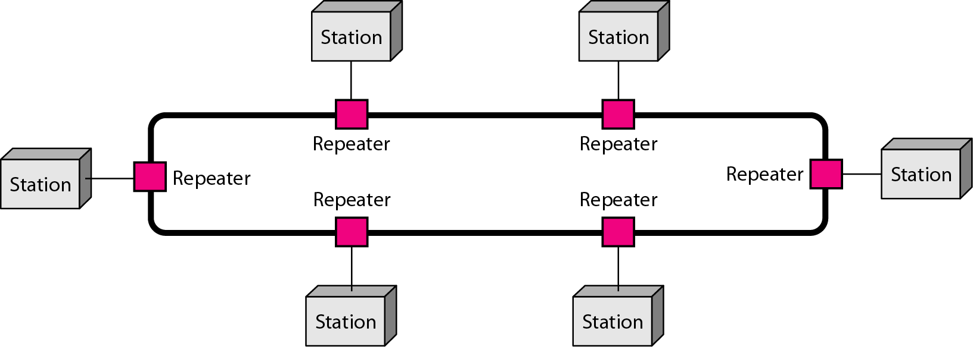
Ring Topology – point-to-point
Each device has a dedicated point-to-point connection with only the two devices on either side of it.
A signal is passed along the ring in one direction, from device to device, until it reaches its destination.
Each device in the ring incorporates a repeater.
When a device receives a signal intended for another device, its repeater regenerates the bits and passes them along.

Slide 31
Advantages
relatively easy to install and reconfigure.
To add or delete a device requires changing only two connections - only constraints are media and traffic considerations (maximum ring length and number of devices.
fault isolation is simplified.
Disadvantage
unidirectional traffic.
a break in the ring (such as a disabled station) can disable the entire network - solved by using a dual ring or a switch capable of closing off the break.
Applications
prevalent when IBM introduced its local-area network, Token Ring.
Some office buildings and School premises.
higher-speed LANs has made this topology less popular.

Slide 32
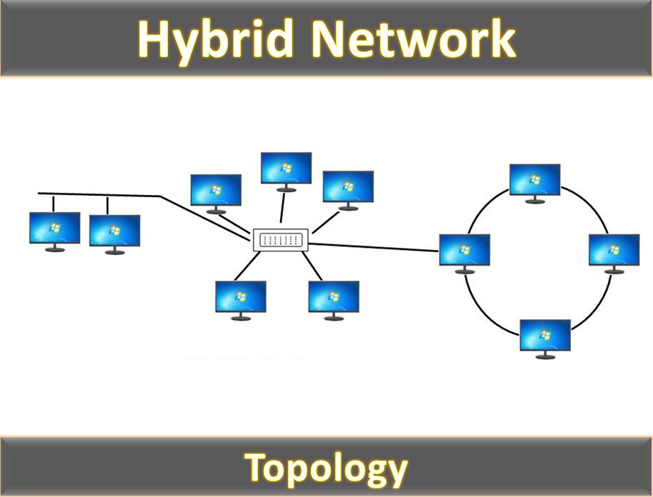
Hybrid Topology :
A type of network topology in which two or more different topologies are integrated or combined to lay out a network

Slide 33
Consideration for choosing the topology
Money: bus network is the least expensive way to install network
Length: length of cable needed the linear bus network uses shorter length of cable
Future growth: with start topology expending a network is easily done by adding another devices
Cable type: most common used cable in commercial organization is twisted pair which often used with star topologies

Slide 34
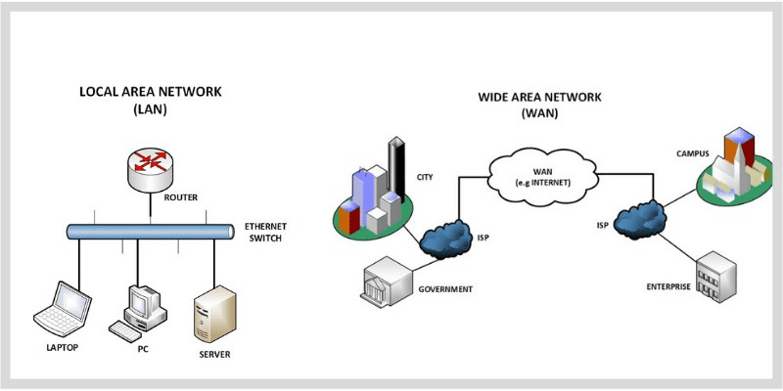
Network Types
We are generally referring to two primary categories:
Local-Area Networks(LAN) and
Wide-Area Networks(WAN)

Slide 35
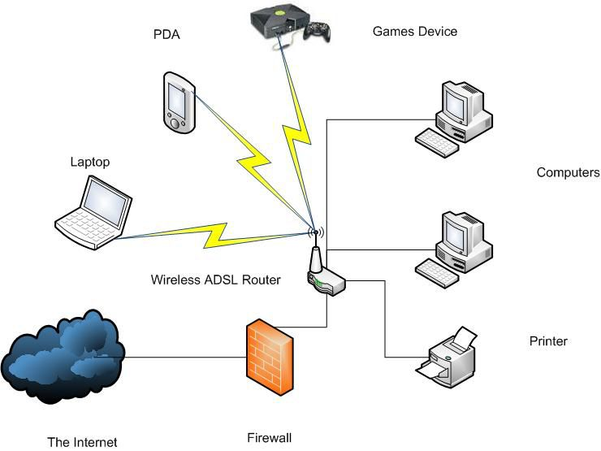
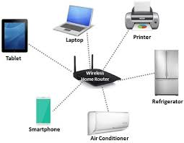
Local Area Network :
Privately owned and links the devices in a single office, building, or campus.
LANs are designed to allow resources to be shared between personal computers or workstations.

Slide 36
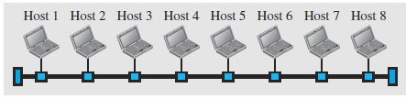
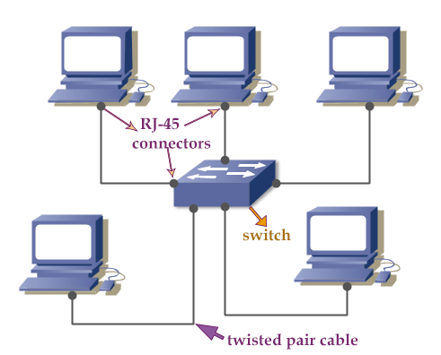
Point to point LAN
Multipoint LAN

Slide 37
All hosts in a network were connected through a common cable.
In addition to size, LANs are distinguished from other types of networks by their transmission media and topology.
LAN does not define the minimum or maximum number of hosts in it.

Slide 38
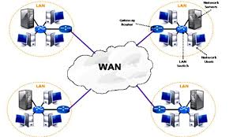
Wide Area Network :
A wide area network (WAN) is also interconnection of devices capable of communication.
A WAN has a wider geographical span, spanning a town, a state, a country or even the world.
WAN interconnects connecting devices such as switches, routers or modem.

Slide 39
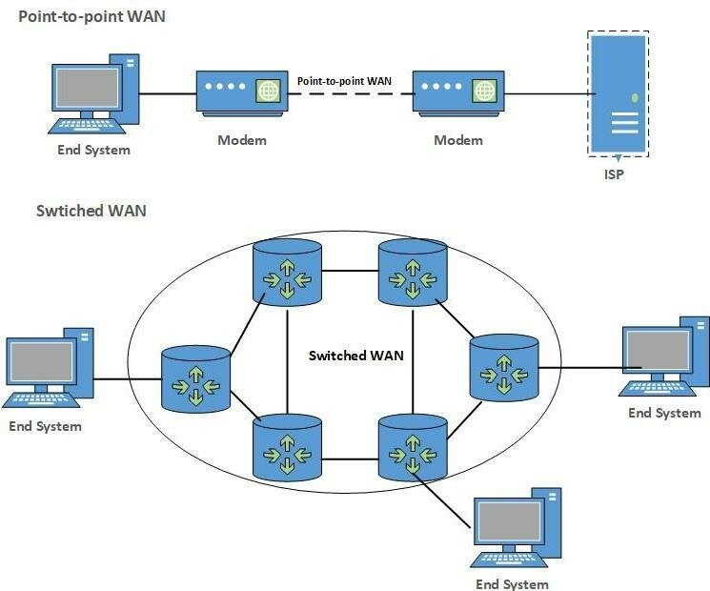
Two examples of WAN are:
Point to point WAN
Switched WANs

Slide 40
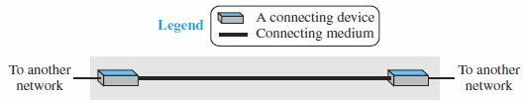
Point-to-Point WAN
Connects two communicating devices through a transmission media (cable or air)

Slide 41
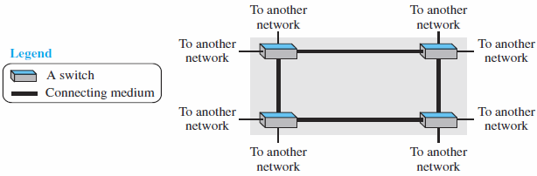
Switched WAN
A network with more than two ends.
Used in the backbone of global communication today.
A combination of several point-to-point WANs that are connected by switches

Slide 42
WAN

Slide 43
Difference between LAN and WAN
LAN | WAN
Normally limited in size, spanning an office, a building, or a campus | Wider geographical span, spanning a town, a state, a country, or even the world
Interconnects hosts | Interconnects connecting devices such as switches, routers, or modems
Normally privately owned by the organization that uses it | Normally created and run by communication companies and leased by an organization that uses it.
Two types: Multipoint LAN and switched LAN | Two types: point-to-point WANs, switched WANs and internetwork

Slide 44
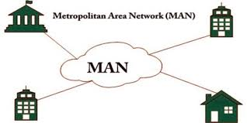
Metropolitan Area Networks
A metropolitan area network (MAN) is a network with a size between a LAN and a WAN.
It is designed for customers who need a high-speed connectivity, normally to the Internet, and have endpoints spread over a city or part of city.

Slide 45
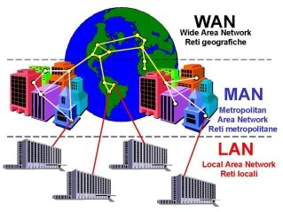

Slide 46
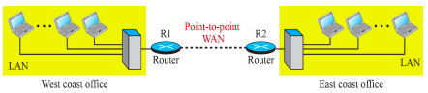
Interconnection of Networks: Internetwork
When two or more networks are connected, they become an internetwork, or internet.
As an example, assume that an organization has two offices, one on the east coast and the other on the west coast.

Slide 47
A heterogeneous internetwork made of four WANs and two LANs

Slide 48
Switched Network
switched network - a switch connects at least two links together
A switch forward data from a network to another network when required
The two most common types of switched networks
circuit-switched
packet-switched networks.

Slide 49
Switching
Communication Network Node
provide switching facility (routing)
Network Station
end node (source &destination)
Communications is achieved by transmitting
data from source to destination through a
network of switching nodes
Communication Network

Slide 50


Switching Technologies
Circuit switching
a dedicated connection, called a circuit,
always available between the two end systems
the switch can only make it active or inactive
A circuit is established for the two parties
Packet switching
Data are put into packets, each stamped with source and destination addresses
Routers know where to forward packets
telephone switch
Packet
Router

Slide 51
The Internet :
An internet (note the lowercase i) is two or more networks that can communicate with each other.
internet is called the Internet (uppercase I) and is composed of thousands of interconnected networks.

Slide 52
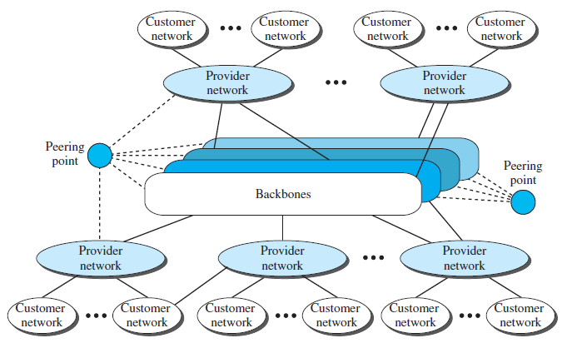
Conceptual (not geographical) view of the Internet

Slide 53
Internet consists of several
Backbones (top level)
large networks owned by some communication companies such as Sprint, Verizon (MCI), AT&T, and NTT
connected through some complex switching systems, called peering points
provider networks (second level) - smaller networks
use the services of the backbones for a fee
connected to backbones and sometimes to other provider networks
Customer networks (the edge of the Internet)
actually use the services provided by the Internet
pay fees to provider networks for receiving services

Slide 54
Backbones and provider networks are also called Internet Service Providers (ISPs)
Backbones = international ISPs
provider networks = national or regional ISPs

Slide 55
Accessing the Internet :
Internet today allows any user to become part of it
User needs to be physically connected to an ISP
The physical connection is normally done through a point-to-point WAN
how user physically connected to an ISP?
Using Telephone Networks
Using Cable Networks
Using Wireless Networks
Direct Connection to the Internet

Slide 56
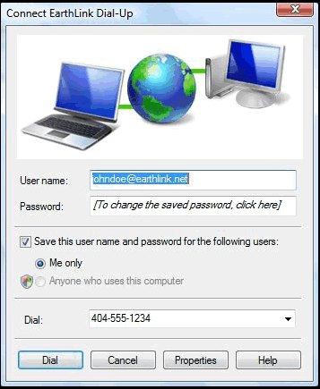
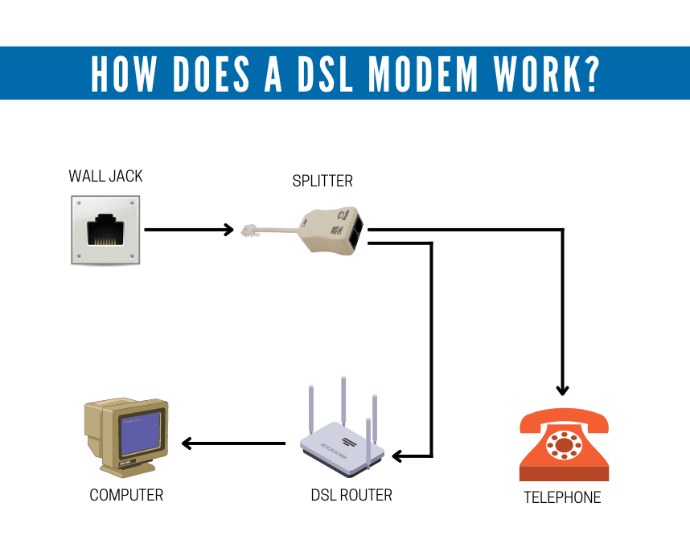
Using Telephone Networks :
Most telephone networks connected themselves to the Internet
residences and small businesses connect to the Internet by changing the voice line between the residence or business and the telephone centre to a point-to-point WAN using one of the way
Dial-up service
DSL Service(Digital Subscriber Line)

Slide 57
Dial-up service
Add the telephone line to a modem that converts data to voice
The software installed on the computer dials the ISP and imitates making a telephone connection
very slow
when the line is used for Internet connection, it cannot be used for telephone (voice) connection
only useful for small residences
DSL Service higher speed Internet services provided to residences or small businesses allows the line to be used simultaneously for voice and data communication

Slide 58
Using Cable Networks :
residents uses cable TV services instead of antennas to receive TV broadcasting over the last two
Cable companies upgrading their cable networks by connecting to the Internet
A residence or a small business with cable TV connection can be connected to the Internet
Cable network provides a higher speed connection
the speed varies depending on the number of neighbours that use the same cable

Slide 59
Using Wireless Networks :
Wireless connectivity has recently become increasingly popular
A household or a small business can use a combination of wireless and wired connections to access the Internet
With the growing wireless WAN access, a household or a small business can be connected to the Internet through a wireless WAN

Slide 60
Direct Connection to the Internet :
A large organization or a large corporation can itself become a local ISP and be connected to the Internet
the organization or the corporation leases a high-speed WAN from a carrier provider and connects itself to a regional ISP
For example, a large university with several campuses can create an internetwork and then connect the internetwork to the Internet

Slide 61
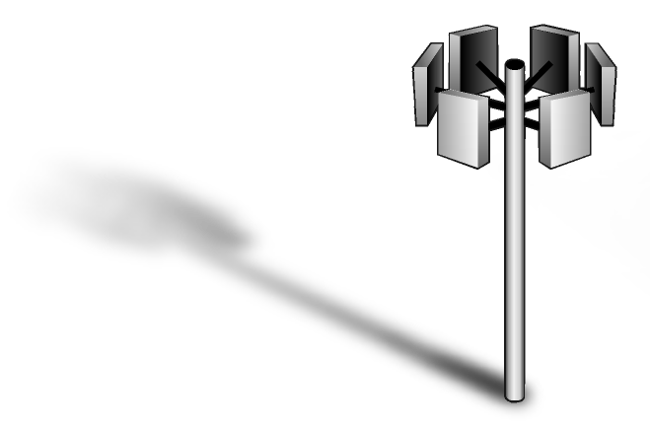

Technologies Around Us
New generation of switching technologies provide improved services to home and workplace
Cable Modem
Frame Relay
Network
ADSL
CATV
Internet
ATM
Network
Cellular 3G/4G/5G
ISDN
Network
E/T-carrier
PSTN
Network
Modem
Notes:
Public carrier circuit have been normally used for connected computers in different sites,. The resulting network is known as a Wide Area Network (WAN). One approach is to lease transmission lines from the public carriers and install a private switching system at each site to create an Enterprise Wide Private Network. Such networks normally incorporate both voice and data communications.
The benefits are such as communication channel is private and online, several data transmission rate is provided from low speed to high speed.

Slide 62
Protocol Layering
A Protocol defines the rules that both the sender and receiver and all intermediate devices need to follow to be able to communicate effectively.
When communication is simple, we need simple protocol.
When communication is complex, we need to divide the task between different layers – Protocol Layering.

Slide 63
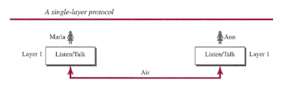
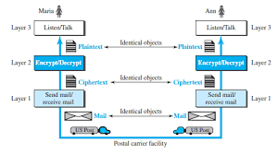
First scenario:
Second scenario:

Slide 64
Advantage:
It allows us to separate the service from implementation.
If we didn’t use protocol layer, we need to make intermediate layer as complex as the end system, which makes the whole system expensive.
Disadvantage:
Some argue that single layer makes job more easier.

Slide 65
Principles of Protocol Layering
First principle:
If we want bidirectional communication, to need to make each layer so that it is able to perform two opposite tasks.
Second Principle:
Two objects under each layer at both the side should be same.

Slide 66
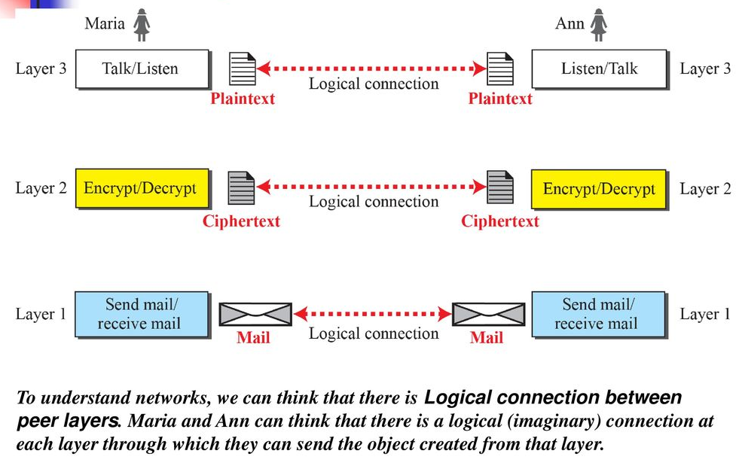

Slide 67
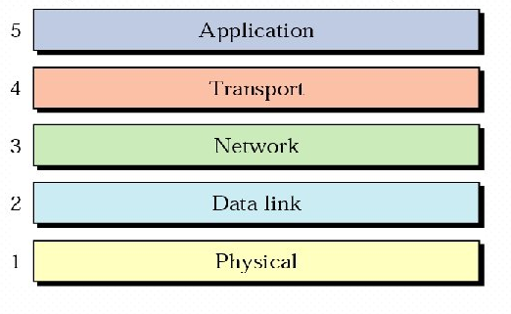
TCP/IP Protocol suite
It is a hierarchical protocol made up of interactive modules, each of which provides a specific functionality.

Slide 68
Layers in TCP/IP Protocol Suite
The original TCP/IP protocol suite was defined as four software layers built upon the hardware.
Today, TCP/IP is thought of as a five-layer model.

Slide 69
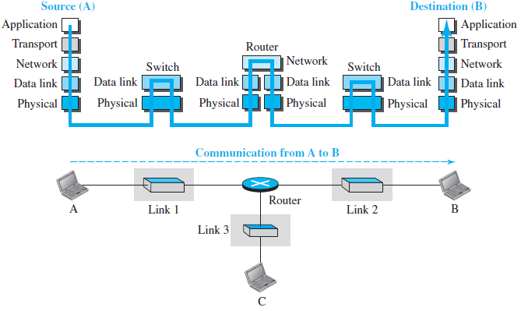
Layered Architecture

Slide 70
Layered Architecture
To show how the layers in the TCP/IP protocol works, we assume that we have following internet
use the suite in a small internet made up of three LANs (links) - each with a link-layer switch.
links are connected by one router
router -> 3-layers
link-layer switch ->2-layers
Notes:
Let us assume that computer A communicates with computer B. As the figure shows, we have five communicating devices in this communication: source host (computer A), the link-layer switch in link 1, the router, the link-layer switch in link 2, and the destination host computer B).
Each device is involved with a set of layers depending on the role of the device in the internet.
The two hosts are involved in all five layers; the source host needs to create a message in the application layer and send it down the layers so that it is physically sent to the destination host. The destination host needs to receive the communication at the physical layer and then deliver it through the other layers to the application layer.
The router is involved in only three layers; there is no transport or application layer in a router as long as the router is used only for routing. Although a router is always involved in one network layer, it is involved in n combinations of link and physical layers in which n is the number of links the router is connected to. The reason is that each link may use its own data-link or physical protocol. For example, in the above figure, the router is involved in three links, but the message sent from source A to destination B is involved in two links. Each link may be using different link-layer and physical-layer protocols; the router needs to receive a packet from link 1 based on one pair of protocols and deliver it to link 2 based on another pair of protocols.
A link-layer switch in a link, however, is involved only in two layers, data-link and physical. Although each switch in the above figure has two different connections, the connections are in the same link, which uses only one set of protocols. This means that, unlike a router, a link-layer switch is involved only in one data-link and one physical layer.

Slide 71
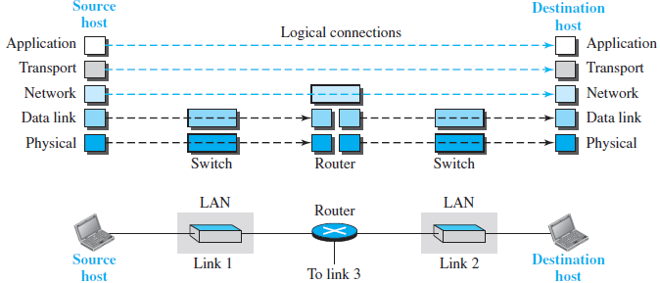
Brief Description of Layers : Logical connections between layers of the TCP/IP protocol suite

Slide 72
To understand the duty of each layer, we need to think about the logical connections between layers.
The duty of the application, transport, and network layers is end-to-end. Their domain of duty is the internet.
The duty of the data-link and physical layers is hop-to-hop, hop is a host or router. Their domain of duty is the link.

Slide 73
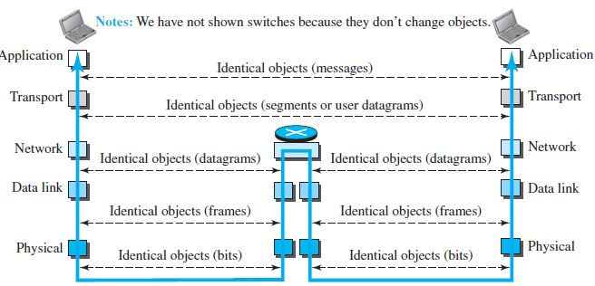
Figure shows the identical objects below each layer related to each device.

Slide 74
Description of Each Layer :
User
Application Layer
Transport Layer
Network Layer
Data Link Layer
Physical Layer
Software
Hardware
Transmission Medium

Slide 75


Application Layer
Responsible for providing services to the user
The only layer to interact with user
Data
Logical communication
Data
Application Layer
SMTP
HTTP
FTP
SMTP
HTTP
FTP
Data
H5
Data
H5
Communication System
to Transport
from Transport

Slide 76
Transport Layer
Responsible for delivery of a message from one process to another
Duties/services
Port addressing
Segmentation and reassembly
Connection control
Flow control (end-to-end)
Error control (end-to-end)

Slide 77
Transport Layer
Process
Process
…
Process
Process
…
PORT #
PORT #
Data
Data
Transport Layer
Data₁
H4
Data₂
H4
Data₃
H4
Data₁
H4
Data₂
H4
Data₃
H4
(segments)
to Network
from Network

Slide 78
Network Layer
Responsible for the delivery of packets from the original source to the destination
Duties/services
Logical addressing
Routing

Slide 79
Network Layer
from Transport
to Transport
Data
Data
Network Layer
Data
H3
Data
H3
(packet)
to Data Link
from Data Link

Slide 80

Network Layer Operation
From transport layer
Data
A1
C7
A.1, A.2, B.1, B.3, ... are logical addresses
A.1
A.2
Network A
A.5
R1
Data
A1
C7
B.7
B.1
Network B
B.6
B.3
B.9
B.2
Data
A1
C7
R3
R2
C.2
C.3
D.1
Router
D.3
Network C
C.7
Network D
Data
A1
C7
D.8
To transport layer

Slide 81
Data Link Layer
Responsible for transmitting frames from one node to the next
Duties/services
Framing
Physical addressing
Flow control (hop-to-hop)
Error control (hop-to-hop)
Access control

Slide 82
Data Link Layer
from Network
to Network
Data
Data
Data Link Layer
T2
Data
H2
T2
Data
H2
(frame)
to Physical
from Physical

Slide 83
Data Link Layer
9F, 3B, 82, 6D, ... are physical addresses
Data
9F
3B
82
6D
T2
Data
9F
6D
H2

Slide 84
Data Link Layer Operation
Data
A.1
C.7
A.1
A.2
97
32
Network A
Data
A.1
C.7
97
25
25
A.5
R1
B.7
B.1
79
Network B
Data
A.1
C.7
79
62
B.6
B.3
62
B.9
12
B.2
R3
R2
C.2
54
C.3
88
D.1
D.3
Data
A.1
C.7
54
74
Network C
C.7
Network D
74
D.8
Data
A.1
C.7
54
74
To network layer

Slide 85
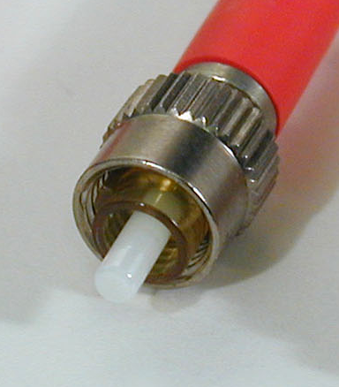
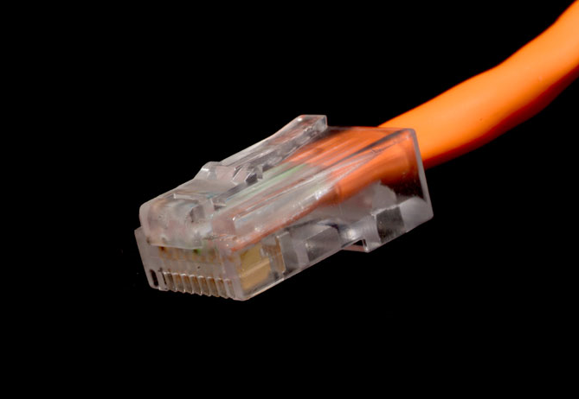
Physical Layer
Responsible for transmitting individual bits from one node to the next
Duties/services
Physical characteristics of interfaces and media
Representation of bits
Data rate (transmission rate)
Synchronization of bits

Slide 86
Physical Layer
from Data Link
to Data Link
Data
Data
Physical Layer
01001011
01001011
(bits)
Transmission medium

Slide 87
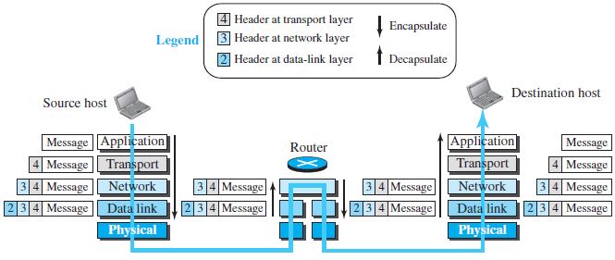
Encapsulation and Decapsulation

Slide 88
OSI Model
User
OSI – Open Systems Interconnection
Developed by the International Standards Organizations (ISO)
Two additional layers
Presentation layer
Session layer
7.Application Layer
6.Presentation Layer
5.Session Layer
4.Transport Layer
3.Network Layer
2.Data Link Layer
1.Physical Layer
Transmission Medium

Slide 89
Session Layer
Responsible for establishing, managing and terminating connections between applications
Duties/services
Interaction management
⇨ Simplex, half-duplex, full-duplex
Session recovery

Slide 90
Presentation Layer
Responsible for handling differences in data representation to applications
Duties/services
Data translation
Encryption
Decryption
Compression

Slide 91
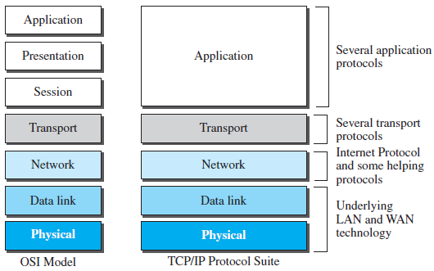
OSI versus TCP/IP

Slide 92
OSI versus TCP/IP
When we compare the two models, we find that two layers, session and presentation, are missing from the TCP/IP protocol suite.
These two layers were not added to the TCP/IP protocol suite after the publication of the OSI model.
The application layer in the suite is usually considered to be the combination of three layers in the OSI model

Slide 93
Lack of OSI Model’s Success :
The OSI model appeared after the TCP/IP protocol suite.
Most experts were at first excited and thought that the TCP/IP protocol would be fully replaced by the OSI model.
This did not happen for several reasons, but we describe only three, which are agreed upon by all experts in the field.
First, OSI was completed when TCP/IP was fully in place and a lot of time and money had been spent on the suite.
Second, some layers in the OSI model were never fully defined.
Third, when OSI was implemented by an organization in a different application, it did not show a high enough level of performance to entice the Internet authority to switch from the TCP/IP protocol suite to the OSI model.

Slide 94
Application Layer
Chapter – 2

Slide 95

Introduction
Interface between the application.
Internet application include classic text based application.

Slide 96
During 1970s and 1980s → text e-mail, remote access to computer, file transfer and newsgroup.
Mid 1990s → World Wide Web, Web Surfing, search, electronic commerce.
2001 → voice over IP, video conferencing(Skype, Facetime, Google hangout), user generated videos(Youtube, Netflix, multiplayer online games).
Later → Facebook, twitter, Instagram.
Recently → location based mobile app, mobile payment app.

Slide 97
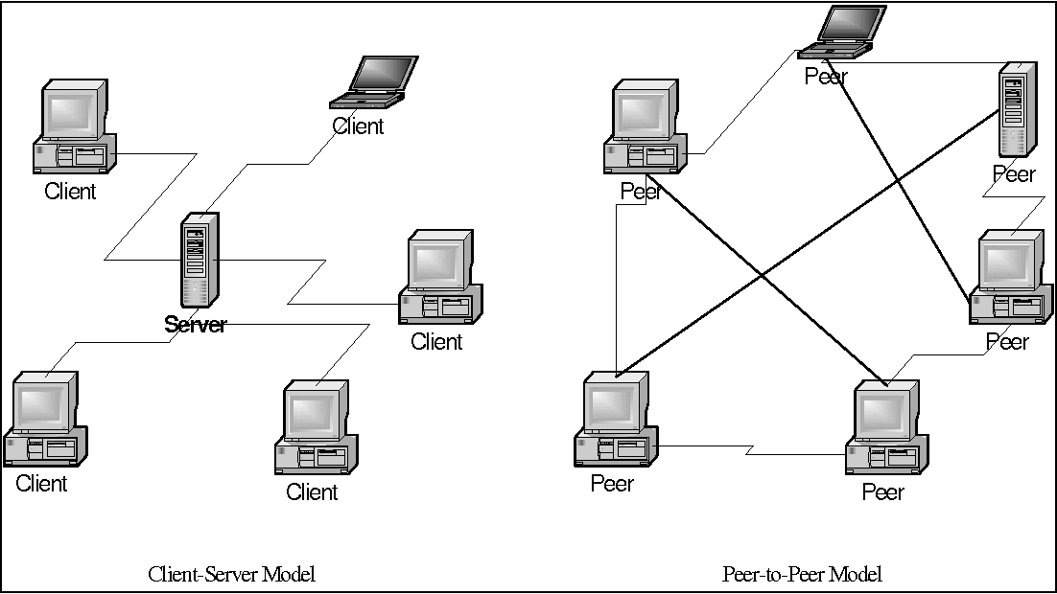
Application architectures
possible structure of applications:
client-server
peer-to-peer (P2P)

Slide 98
App-layer protocol defines :
types of messages exchanged,
e.g., request, response
message syntax:
what fields in messages & how fields are delineated
message semantics
meaning of information in fields
rules for when and how processes send & respond to messages
open protocols:
defined in RFCs
allows for interoperability
e.g., HTTP, SMTP
proprietary protocols:
e.g., Skype

Slide 99
The Web and HTTP
The Web was the first Internet application that caught the general public’s eye.
The Web operates on demand.
Hyperlinks and search engines help us navigate through an ocean of information.
Forms, JavaScript, video, and many other devices enable us to interact with pages and sites.
The Web and its protocols serve as a platform for YouTube, Web-based e-mail (such as Gmail), and most mobile Internet applications, including Instagram and Google Maps.

Slide 100
Overview of HTTP:
HyperText Transfer Protocol.
It is defined in [RFC 1945], [RFC 7230] and [RFC 7540].
HTTP is implemented in two programs: a client program and a server program.

Slide 101
Some web terminology:
Web page
Object
Base HTML file
URL
Web browser
Web Servers

Slide 102
Web and HTTP
First, a review…
web page consists of objects
object can be HTML file, JPEG image, Java applet, audio file,…
web page consists of base HTML-file which includes several referenced objects
each object is addressable by a URL, e.g.,
www.someschool.edu/someDept/pic.gif
host name of server that houses the object
path name of object

Slide 103


HTTP request
PC running
Firefox browser
HTTP response
server
running
Apache Web
server
HTTP request
HTTP response
iphone running
Safari browser
HTTP request-response behavior

Slide 104
HTTP uses TCP as its underlying transport protocol. The HTTP client first initiates a TCP connection with the server.
Server processes access TCP through their socket interfaces.
TCP provides a reliable data transfer service to HTTP.
It is important to note that the server sends requested files to clients without storing any state information about the client.
Because an HTTP server maintains no information about the clients, HTTP is said to be a stateless protocol.

Slide 105
Non-Persistent and Persistent Connections
Non-persistent HTTP
TCP connection opened
at most one object sent over TCP connection
TCP connection closed
downloading multiple objects required multiple connections
Persistent HTTP
TCP connection opened to a server
multiple objects can be sent over single TCP connection between client, and that server
TCP connection closed

Slide 106
Non-persistent HTTP
(contains text,
references to 10
jpeg images)
suppose user enters URL:
www.someSchool.edu/someDepartment/home.index
1a. HTTP client initiates TCP connection to HTTP server (process) at www.someSchool.edu on port 80
1b. HTTP server at host www.someSchool.edu waiting for TCP connection at port 80. “accepts” connection, notifying client
2. HTTP client sends HTTP request message (containing URL) into TCP connection socket. Message indicates that client wants object someDepartment/home.index
3. HTTP server receives request message, forms response message containing requested object, and sends message into its socket
time

Slide 107
Non-persistent HTTP (cont.)
4. HTTP server closes TCP connection.
5. HTTP client receives response message containing html file, displays html. Parsing html file, finds 10 referenced jpeg objects
time
6. Steps 1-5 repeated for each of 10 jpeg objects

Slide 108
Non-persistent HTTP: response time
RTT (definition): time for a small packet to travel from client to server and back
HTTP response time:
one RTT to initiate TCP connection
one RTT for HTTP request and first few bytes of HTTP response to return
file transmission time
non-persistent HTTP response time =
2RTT+ file transmission time
initiate TCP
connection
RTT
request
file
RTT
time to
transmit
file
file
received
time
time

Slide 109
Persistent HTTP
non-persistent HTTP issues:
requires 2 RTTs per object
OS overhead for each TCP connection
browsers often open parallel TCP connections to fetch referenced objects
persistent HTTP:
server leaves connection open after sending response
subsequent HTTP messages between same client/server sent over open connection
client sends requests as soon as it encounters a referenced object
as little as one RTT for all the referenced objects

Slide 110
HTTP Message Format
GET
POST
HEAD
PUT
DELETE
Two types of HTTP messages: request, response
HTTP Request Message:
GET /somedir/page.html HTTP/1.1
Host: www.someschool.edu
Connection: close
User-agent: Mozilla/5.0
Accept-language: fr
Method
URL
Version
request line
GET /index.html HTTP/1.1\r\n
Host: www-net.cs.umass.edu\r\n
User-Agent: Firefox/3.6.10\r\n
Accept: text/html,application/xhtml+xml\r\n
Accept-Language: en-us,en;q=0.5\r\n
Accept-Encoding: gzip,deflate\r\n
Accept-Charset: ISO-8859-1,utf-8;q=0.7\r\n
Keep-Alive: 115\r\n
Connection: keep-alive\r\n
\r\n
Header Lines

Slide 111
HTTP request message: general format
method
sp
URL
sp
version
cr
lf
request
line
header field name
value
cr
lf
~
~
header
lines
~
~
header field name
value
cr
lf
cr
lf
~
entity body
~
body
~
~

Slide 112
Method | Action
GET | Requests a document from the server
HEAD | Requests information about a document but not the document itself
PUT | Sends a document from the client to the server
POST | Sends some information from the client to the server
DELETE | Removes the web page
TRACE | Echoes the incoming request
CONNECT | Reserved
OPTIONS | Inquires about available options

Slide 113
HTTP response message
status line
(protocol
status code
status phrase)
HTTP/1.1 200 OK\r\n
Date: Sun, 26 Sep 2010 20:09:20 GMT\r\n
Server: Apache/2.0.52 (CentOS)\r\n
Last-Modified: Tue, 30 Oct 2007 17:00:02 GMT\r\n
ETag: "17dc6-a5c-bf716880"\r\n
Accept-Ranges: bytes\r\n
Content-Length: 2652\r\n
Keep-Alive: timeout=10, max=100\r\n
Connection: Keep-Alive\r\n
Content-Type: text/html; charset=ISO-8859-1\r\n
\r\n
data data data data data ...
header
lines
Entity Body
data, e.g.,
requested
HTML file

Slide 114
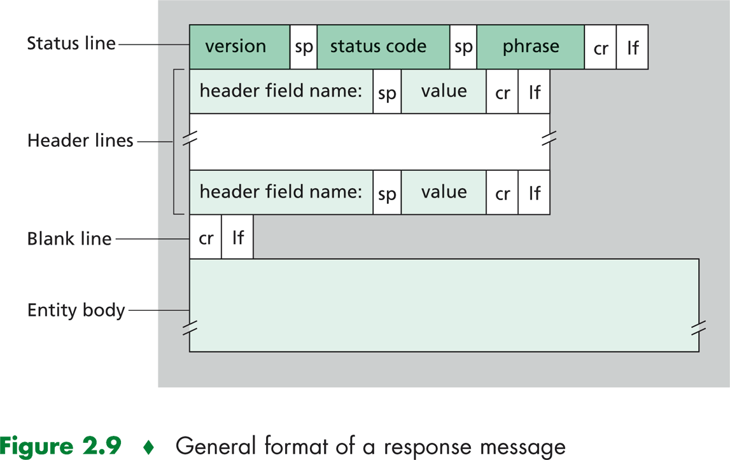

Slide 115
Some common status codes and associated phrases include:
status codes | associated phrases
200 OK | Request succeeded and the information is returned in the response.
301 Moved Permanently | Requested object has been permanently moved; the new URL is specified in Location: header of the response message. The client software will automatically retrieve the new URL.
400 Bad Request | This is a generic error code indicating that the request could not be understood by the server.
404 Not Found | The requested document does not exist on this server.
505 HTTP Version Not Supported | The requested HTTP protocol version is not supported by the server

Slide 116
User-Server Interaction: Cookies
Recall: HTTP GET/response interaction is stateless
Cookies, allow sites to keep track of users. Most major commercial Web sites use cookies today.
Cookie technology has four components:
A cookie header line in the HTTP response message;
A cookie header line in the HTTP request message;
A cookie file kept on the user’s end system and managed by the user’s browser; and
A back-end database at the Web site.

Slide 117
Maintaining user/server state: cookies
client
server
ebay 8734
usual HTTP request msg
Amazon server
creates ID
1678 for user
cookie file
usual HTTP response
set-cookie: 1678
backend
database
create
entry
ebay 8734
amazon 1678
usual HTTP request msg
cookie: 1678
cookie-
specific
action
access
one week later:
usual HTTP response msg
access
usual HTTP request msg
cookie: 1678
ebay 8734
amazon 1678
cookie-
specific
action
usual HTTP response msg
time
time

Slide 118
What cookies can be used for:
authorization
shopping carts
recommendations
user session state (Web e-mail)
cookies and privacy:
cookies permit sites to learn a lot about you on their site.
third party persistent cookies (tracking cookies) allow common identity (cookie value) to be tracked across multiple web sites

Slide 119
Web Caching
A Web cache—also called a proxy server—is a network entity that satisfies HTTP requests on the behalf of an origin Web server.
The Web cache has its own disk storage and keeps copies of recently requested objects in this storage.

Slide 120
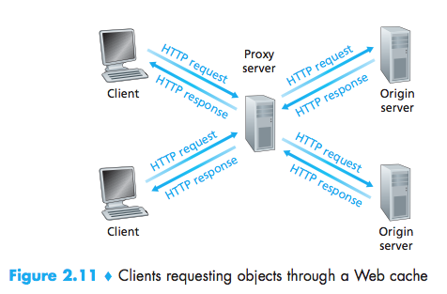
user configures browser to point to a (local) Web cache
browser sends all HTTP requests to cache
if object in cache: cache returns object to client
else cache requests object from origin server, caches received object, then returns object to client

Slide 121
A cache is both a server and a client at the same time.
Why Web caching?
reduce response time for client request
cache is closer to client
reduce traffic on an institution’s access link to the Internet. By reducing traffic, the institution does not have to upgrade bandwidth as quickly, thereby reducing costs.
Furthermore, Web caches can substantially reduce Web traffic in the Internet as a whole, thereby improving performance for all applications.

Slide 122
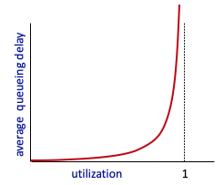


Caching example
Scenario:
access link rate: 1.54 Mbps
RTT from institutional router to server: 2 sec
web object size: 100K bits
average request rate from browsers to origin servers: 15/sec
avg data rate to browsers: 1.50 Mbps
origin
servers
public
Internet
1.54 Mbps
access link
Performance:
access link utilization = .97
LAN utilization: .0015
end-end delay = Internet delay +
access link delay + LAN delay
= 2 sec + minutes + usecs
problem: large queueing delays at high utilization!
1 Gbps LAN
institutional
network
Notes:
explain why minutes (recall earlier delay versus arrival rate curve from Chapter 1)

Slide 123
Option 1: buy a faster access link
154 Mbps
Scenario:
access link rate: 1.54 Mbps
RTT from institutional router to server: 2 sec
web object size: 100K bits
average request rate from browsers to origin servers: 15/sec
avg data rate to browsers: 1.50 Mbps
origin
servers
public
Internet
154 Mbps
1.54 Mbps
access link
Performance:
access link utilization = .97
LAN utilization: .0015
end-end delay = Internet delay +
access link delay + LAN delay
= 2 sec + minutes + usecs
.0097
institutional
network
1 Gbps LAN
msecs
Cost: faster access link (expensive!)
Notes:
t’

Slide 124
Option 2: install a web cache
Scenario:
access link rate: 1.54 Mbps
RTT from institutional router to server: 2 sec
web object size: 100K bits
average request rate from browsers to origin servers: 15/sec
avg data rate to browsers: 1.50 Mbps
origin
servers
public
Internet
1.54 Mbps
access link
Cost: web cache (cheap!)
institutional
network
Performance:
LAN utilization: .?
access link utilization = ?
average end-end delay = ?
1 Gbps LAN
How to compute link
utilization, delay?
local web cache
Notes:
t’

Slide 125
Calculating access link utilization, end-end delay with cache:
suppose cache hit rate is 0.4:
40% requests served by cache, with low (msec) delay
origin
servers
public
Internet
60% requests satisfied at origin
rate to browsers over access link
= 0.6 * 1.50 Mbps = .9 Mbps
access link utilization = 0.9/1.54 = .58 means low (msec) queueing delay at access link
1.54 Mbps
access link
institutional
network
average end-end delay:
= 0.6 * (delay from origin servers)
+ 0.4 * (delay when satisfied at cache)
= 0.6 (2.01) + 0.4 (~msecs) = ~ 1.2 secs
1 Gbps LAN
lower average end-end delay than with 154 Mbps link (and cheaper too!)
local web cache
Notes:
t’

Slide 126
The Conditional GET
Although caching can reduce user-perceived response times, it introduces a new problem—the copy of an object residing in the cache may be stale.
HTTP has a mechanism that allows a cache to verify that its objects are up to date. This mechanism is called the conditional GET.
An HTTP request message is a so-called conditional GET message if (1) the request message uses the GET method and (2) the request message includes an If-Modified-Since: header line.

Slide 127
First, on the behalf of a requesting browser, a proxy cache sends a request message to a Web server:
GET /fruit/kiwi.gif HTTP/1.1
Host: www.exotiquecuisine.com
Second, the Web server sends a response message with the requested object to the cache:
HTTP/1.1 200 OK
Date: Sat, 3 Oct 2015 15:39:29
Server: Apache/1.3.0 (Unix)
Last-Modified: Wed, 9 Sep 2015 09:23:24
Content-Type: image/gif
(data data data data data ...)

Slide 128
The cache forwards the object to the requesting browser but also caches the object locally. Importantly, the cache also stores the last-modified date along with the object.
Third, one week later, another browser requests the same object via the cache, and the object is still in the cache. Since this object may have been modified at the Web server in the past week, the cache performs an up-to-date check by issuing a conditional GET. Specifically, the cache sends:
GET /fruit/kiwi.gif HTTP/1.1
Host: www.exotiquecuisine.com
If-modified-since: Wed, 9 Sep 2015 09:23:24

Slide 129
Suppose the object has not been modified since 9 Sep 2015 09:23:24. Then, fourth, the Web server sends a response message to the cache:
HTTP/1.1 304 Not Modified
Date: Sat, 10 Oct 2015 15:39:29
Server: Apache/1.3.0 (Unix)
(empty entity body)

Slide 130
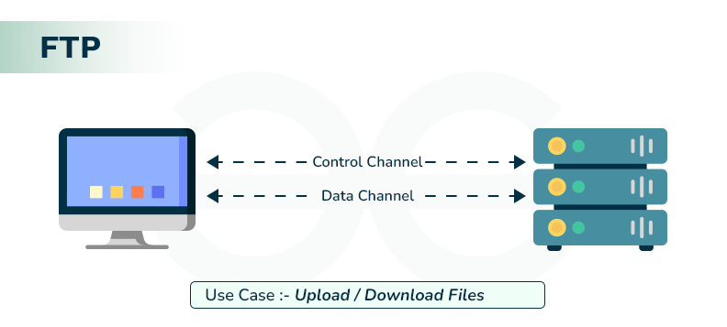
FTP – File Transfer protocol
File Transfer Protocol (FTP) is the standard protocol provided by TCP/IP for copying a file from one host to another.
Problems:
Two systems may use different file name conventions, have different ways to represent data, and have different directory structures.
Solution:
FTP is a better choice to transfer large files or to transfer files using different formats.

Slide 131
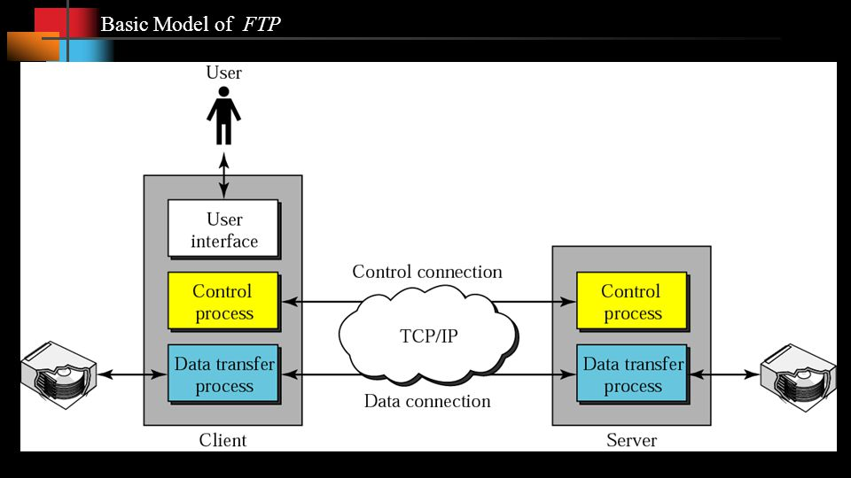
Local file system
Remote file system

Slide 132
The client has three components: user interface, client control process, and the client data transfer process.
The server has two components: server control process and server data transfer process.
The control connection is made between the control processes.
The data connection is made between the data transfer processes.
The control connection uses very simple rules of communication. We need to transfer only a line of command or a line of response at a time.
The data connection, on the other hand, needs more complex rules due to the variety of data types transferred.

Slide 133
Lifetimes of Two Connections:
The control connection remains connected during the entire interactive FTP session.
The data connection is opened and then closed for each file transfer activity. It opens each time commands that involve transferring files are used, and it closes when the file is transferred.

Slide 134
Control Connection
For control communication, FTP uses the same approach as TELNET.
Communication is achieved through commands and responses.
Each line is terminated with a two-character (carriage return and line feed) end-of-line token.

Slide 135
Some common FTP commands :
Command | Argument(s) | Description
ABOR |  | Abort the previous command
CDUP |  | Change to parent directory
CWD | Directory name | Change to another directory
DELE | File name | Delete a file
LIST | Directory name | List subdirectories or files
MKD | Directory name | Create a new directory
PASS | User password | Password
PASV |  | Server chooses a port
PORT | Port identifier | Client chooses a port
PWD |  | Display name of current directory
QUIT |  | Log out of the system

Slide 136
Command | Argument(s) | Description
RETR | File name(s) | Retrieve files; files are transferred from server to client
RMD | Directory name | Delete a directory
RNFR | File name (old) | Identify a file to be renamed
RNTO | File name (new) | Rename the file
STOR | File name(s) | Store files; file(s) are transferred from client to server
STRU | F, R, or P | Define data organization (F: file, R: record, or P: page)
TYPE | A, E, I | Default file type (A: ASCII, E: EBCDIC, I: image)
USER | User ID | User information
MODE | S, B, or C | Define transmission mode (S: stream, B: block, or C: compressed)

Slide 137
Every FTP command generates at least one response.
A response has two parts: a three-digit number followed by text.
The numeric part defines the code;
the text part defines needed parameters or further explanations.
The first digit defines the status of the command.
The second digit defines the area in which the status applies.
The third digit provides additional information.

Slide 138
Some common responses in FTP :
Code | Description | Code | Description
125 | Data connection open | 250 | Request file action OK
150 | File status OK | 331 | User name OK; password is needed
200 | Command OK | 425 | Cannot open data connection
220 | Service ready | 450 | File action not taken; file not available
221 | Service closing | 452 | Action aborted; insufficient storage
225 | Data connection open | 500 | Syntax error; unrecognized command
226 | Closing data connection | 501 | Syntax error in parameters or arguments
230 | User login OK | 530 | User not logged in

Slide 139
Data Connection :
The data connection uses port 20 at the server site.
The steps are as follows:
1. The client, not the server, issues a passive open using an ephemeral port. This must be done by the client because it is the client that issues the commands for transferring files.
2. The client sends this port number to the server using the PORT command.
3. The server receives the port number and issues an active open using the well-known port 20 and the received ephemeral port number.

Slide 140
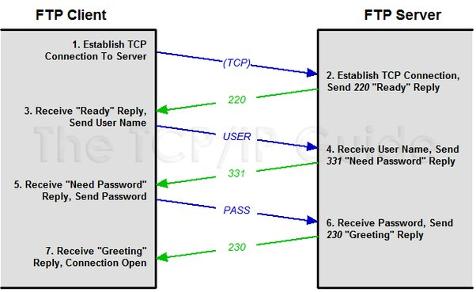
Example:

Slide 141
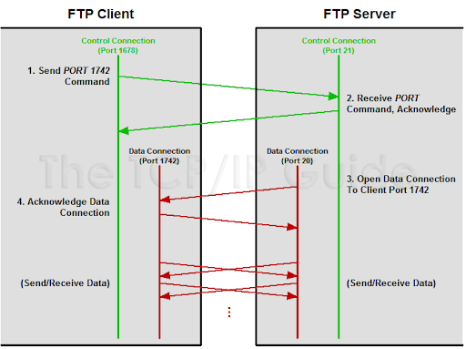

Slide 142
Electronic Mail in the Internet
As with ordinary postal mail, e-mail is an asynchronous communication medium—people send and read messages when it is convenient for them, without having to coordinate with other people’s schedules.
In contrast with postal mail, electronic mail is fast, easy to distribute, and inexpensive.
Modern e-mail has many powerful features, including messages with attachments, hyperlinks, HTML-formatted text, and embedded photos.

Slide 143
A high-level view of the Internet e-mail system
user
agent
outgoing
message queue
mail
server
user
agent
user mailbox
SMTP
mail
server
user
agent
SMTP
SMTP
user
agent
mail
server
user
agent
user
agent

Slide 144
It has three major components:
user agents,
mail servers, and
the Simple Mail Transfer Protocol (SMTP).
User agents allow users to read, reply to, forward, save, and compose messages.
Examples of user agents for e-mail include Microsoft Outlook, Apple Mail, Web-based Gmail, the Gmail App running in a smartphone, and so on.
When Alice is finished composing her message, her user agent sends the message to her mail server, where the message is placed in the mail server’s outgoing message queue.
When Bob wants to read a message, his user agent retrieves the message from his mailbox in his mail

Slide 145
SMTP is the principal application-layer protocol for Internet electronic mail.
As with most application-layer protocols, SMTP has two sides: a client side, which executes on the sender’s mail server, and a server side, which executes on the recipient’s mail server.
Both the client and server sides of SMTP run on every mail server.
When a mail server sends mail to other mail servers, it acts as an SMTP client.
When a mail server receives mail from other mail servers, it acts as an SMTP server.

Slide 146
SMTP – Simple Mail Transfer Protocol
SMTP transfers messages from senders’ mail servers to the recipients’ mail servers.
SMTP is much older than HTTP(messages must be in 7-bit ASCII).
SMTP doesn't normally use intermediate mail server.
Once the connection is established, the server and client perform some application layer handshaking.

Slide 147


Scenario: Alice sends message to Bob
1) Alice uses UA to compose message “to” bob@someschool.edu
2) Alice’s UA sends message to her mail server; message placed in message queue
3) client side of SMTP opens TCP connection with Bob’s mail server
4) SMTP client sends Alice’s message over the TCP connection
5) Bob’s mail server places the message in Bob’s mailbox
6) Bob invokes his user agent to read message
user
agent
mail
server
user
agent
1
mail
server
2
3
6
4
Alice’s mail server
5
Bob’s mail server

Slide 148
Sample SMTP interaction
S: 220 hamburger.edu
C: HELO crepes.fr
S: 250 Hello crepes.fr, pleased to meet you
C: MAIL FROM: <alice@crepes.fr>
S: 250 alice@crepes.fr... Sender ok
C: RCPT TO: <bob@hamburger.edu>
S: 250... Recipient ok
C: DATA bob@hamburger.edu
S: 354 Enter mail, end with "." on a line by itself
C: Do you like ketchup?
C: How about pickles?
C: . → end of the message
S: 250 Message accepted for delivery
C: QUIT
S: 221 hamburger.edu closing connection
Message:
Do you like ketchup?
How about pickles?
Commands:
HELO, MAIL, FROM, RCPT TO, DATA and QUIT

Slide 149
Try SMTP interaction for yourself:
telnet servername 25
see 220 reply from server
enter HELO, MAIL FROM, RCPT TO, DATA, QUIT commands
above lets you send email without using email client (reader)

Slide 150

Mail Message Formats:
header lines, e.g.,
To:
From:
Subject:
Example:
From: alice@crepes.fr
To: bob@hamburger.edu
Subject: Searching for the meaning of life.
header
body

Slide 151
Mail Access Protocols
SMTP
mail access
protocol
user
agent
user
agent
SMTP or HTTP
HTTP or IMAP
sender’s mail
server
receiver’s mail
server
SMTP: delivery/storage to receiver’s server
Mail access protocol: retrieval from server
POP: Post Office Protocol [RFC 1939]: authorization, download
IMAP: Internet Mail Access Protocol [RFC 1730]: more features, including manipulation of stored msgs on server
HTTP: gmail, Hotmail, Yahoo! Mail, etc.

Slide 152
DNS—The Internet’s Directory Service
Just as humans can be identified in many ways, so too can Internet hosts. One identifier for a host is its hostname.
Hostnames → www.facebook.com, www.google.com, gaia.cs.umass.edu
Hostnames can consist of variable-length alphanumeric characters, they would be difficult to process by routers. For these reasons, hosts are also identified by so-called IP addresses.
An IP address looks like 121.7.106.83, where each period separates one of the bytes expressed in decimal notation from 0 to 255.

Slide 153
Services Provided by DNS :
Two ways to identify a host – Hostname and IP address.
A directory service that translates hostnames to IP addresses → Internet’s Domain Name System (DNS).
The DNS protocol runs over UDP and uses port 53.
The DNS is
A distributed database implemented in a hierarchy of DNS servers, and
An application-layer protocol that allows hosts to query the distributed database.

Slide 154
Example:
http://www.someschool.edu/index.html
This is done as follows.
The same user machine runs the client side of the DNS application.
The browser extracts the hostname, www.someschool.edu, from the URL and passes the hostname to the client side of the DNS application.
The DNS client sends a query containing the hostname to a DNS server.
The DNS client eventually receives a reply, which includes the IP address for the hostname.
Once the browser receives the IP address from DNS, it can initiate a TCP connection to the HTTP server process located at port 80 at that IP address.

Slide 155
DNS provides a few other important services:
Hostname to IP address translation.
Host aliasing
canonical, alias names
For example
relay1.west-coast .enterprise.com → enterprise.com and www.enterprise.com
Mail Server aliasing
For example:
bob@yahoo.com → yahoo.com
Load Distribution
replicated Web servers: many IP addresses correspond to one name

Slide 156
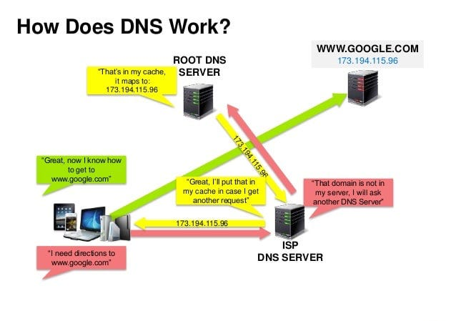

Slide 157
The problems with a centralized design include:
A single point of failure: If the DNS server crashes, so does the entire Internet!
Traffic volume: A single DNS server would have to handle all DNS queries
Distant centralized database: A single DNS server cannot be “close to” all the querying clients. This can lead to significant delays.
Maintenance: The single DNS server would have to keep records for all Internet hosts.
A centralized database in a single DNS server simply doesn’t scale.

Slide 158
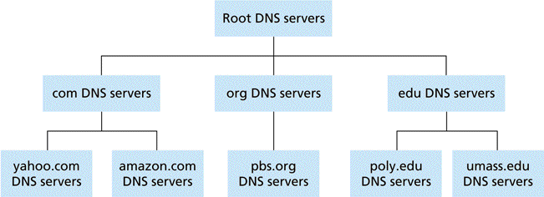
A Distributed, Hierarchical Database :
In order to deal with the issue of scale, the DNS uses a large number of servers, organized in a hierarchical fashion and distributed around the world.
Root DNS Server
Top Level Domain(TLD) DNS Server
Authoritative DNS Server
Portion of the hierarchy of DNS servers

Slide 159
Client wants IP address for www.amazon.com;
1st approximation:
client queries root server to find .com DNS server
client queries .com DNS server to get amazon.com DNS server
client queries amazon.com DNS server to get IP address for www.amazon.com

Slide 160

Example:

Slide 161
There is another important type of DNS server called the local DNS server. A local DNS server does not strictly belong to the hierarchy of servers but is nevertheless central to the DNS architecture.

Slide 162
DNS name resolution example:
Root DNS server
2
Host at cis.poly.edu wants IP address for gaia.cs.umass.edu
3
TLD DNS server
4
5
local DNS server
dns.poly.edu
iterated query:
contacted server replies with name of server to contact
“I don’t know this name, but ask this server”
7
6
1
8
authoritative DNS server
dns.cs.umass.edu
requesting host
cis.poly.edu
gaia.cs.umass.edu

Slide 163
root DNS server
DNS name resolution example
2
3
7
recursive query:
puts burden of name resolution on contacted name server
heavy load at upper levels of hierarchy?
6
TLD DNS
server
local DNS server
dns.poly.edu
5
4
1
8
authoritative DNS server
dns.cs.umass.edu
requesting host
cis.poly.edu
gaia.cs.umass.edu

Slide 164
DNS Caching :
DNS extensively exploits DNS caching in order to improve the delay performance and to reduce the number of DNS messages ricocheting around the Internet.
By no means permanent, DNS servers discard cached information after a period of time (often set to two days).

Slide 165
DNS Records and Messages
DNS distributed database store resource records (RRs).
A resource record is a four-tuple that contains the following fields:
(Name, Value, Type, TTL)
TTL - time to live of the resource record
The meaning of Name and Value depend on Type

Slide 166
Type | Name | Value | Example
A | hostname | IP address for the host-name | (relay1.bar.foo.com, 145.37.93.126, A) provides the standard hostname-to-IP address mapping.
NS | domain | Host- name of an authoritative DNS server | (foo.com, dns.foo.com, NS) used to route DNS queries further along in the query chain.
CNAME | Alias hostname | canonical hostname | (foo.com, relay1.bar.foo.com, CNAME) provide querying hosts the canonical name for a hostname.
MX | Alias hostname | canonical name of a mail server | (foo.com, mail.bar.foo.com, MX) allow the hostnames of mail servers to have simple aliases.

Slide 167

DNS Messages :
Two kinds of DNS messages : DNS query and reply messages -- same format.
query (0) or a reply (1)
16-bit number
Header Section
DNS Message Format

Slide 168
To send a DNS query message directly from the host you’re working on to some DNS server → nslookup program.
Inserting Records into the DNS Database
Example: created an exciting new startup company called Network Utopia.
The first thing to do is register the domain name networkutopia.com at a registrar → commercial entity that verifies the uniqueness of the domain name, enters the domain name into the DNS database and collects a small fee from you for its services.

Slide 169
need to provide the registrar with the names and IP addresses of your primary and secondary authoritative DNS servers.
Suppose the names and IP addresses are dns1.networkutopia.com, dns2.networkutopia.com, 212.2.212.1, and 212.212.212.2.
The registrar would then make sure that a Type NS and a Type A record are entered into the TLD com servers.
(networkutopia.com, dns1.networkutopia.com, NS) (dns1.networkutopia.com, 212.212.212.1, A)
The Type A resource record for your Web server www.networkutopia.com and the Type MX resource record for your mail server mail.networkutopia.com are entered into your authoritative DNS servers.

Slide 170

Peer-to-Peer File Distribution
Pairs of intermittently connected hosts, called peers, communicate directly with each other.
The peers are not owned by a service provider, but are instead PCs, laptops, and smartphones controlled by users.

Slide 171
P2P application → distributing a large file from a single server to a large number of hosts (called peers).
The most popular P2P file distribution protocol is BitTorrent. Originally developed by Bram Cohen.

Slide 172
File distribution: client-server vs P2P
Question: how much time to distribute file (size F) from one server to N peers?
peer upload/download capacity is limited resource
u_{s}: server upload capacity
d_{i}: peer i download capacity
file, size F
u₁
d₁
u₂
u_{s}
d₂
server
d_{i}
u_{N}
network (with abundant
bandwidth)
u_{i}
d_{N}
u_{i}: peer i upload capacity

Slide 173
File distribution time: client-server
server transmission: must sequentially send (upload) N file copies:
time to send one copy: F/u_{s}
time to send N copies: NF/u_{s}
F
u_{s}
d_{i}
network
u_{i}
client: each client must download file copy
d_{min} = min client download rate
min client download time: F/d_{min}
time to distribute F
to N clients using
client-server approach
D_{c-s} > max{NF/u_{s,},F/d_{min}}
increases linearly in N

Slide 174
File distribution time: P2P
server transmission: must upload at least one copy
time to send one copy: F/u_{s}
F
u_{s}
d_{i}
network
client: each client must download file copy
min client download time: F/d_{min}
u_{i}
clients: as aggregate must download NF bits
max upload rate (limting max download rate) is u_{s} + Σu_{i}
time to distribute F
to N clients using
P2P approach
D_{P2P} > max{F/u_{s,},F/d_{min,},NF/(u_{s} + Σu_{i})}
increases linearly in N …
… but so does this, as each peer brings service capacity

Slide 175
Distribution time for P2P and client-server architectures
client upload rate = u, F/u = 1 hour, u_{s} = 10u, d_{min} ≥ u_{s}

Slide 176
BitTorrent :
BitTorrent is a popular P2P protocol for file distribution.
In BitTorrent lingo, the collection of all peers participating in the distribution of a particular file is called a torrent.
Peers in a torrent download equal-size chunks of the file from one another, with a typical chunk size of 256 KBytes.

Slide 177

♦ File distribution with BitTorrent
tracker: tracks peers
participating in torrent
Alice arrives …
… obtains list
of peers from tracker
… and begins exchanging
file chunks with peers in torrent

Slide 178
So at any given instant of time, Alice will have a subset of chunks and will know which chunks her neighbors have.
Alice will have two important decisions to make.
First, which chunks should she request first from her neighbors? And
second, to which of her neighbors should she send requested chunks?
Alice uses a technique called rarest first.
The idea is to determine, from among the chunks she does not have, the chunks that are the rarest among her neighbors and then request those rarest chunks first.

Slide 179
To determine which requests she responds to, BitTorrent uses a clever trading algorithm.
The basic idea is that Alice gives priority to the neighbors that are currently supplying her data at the highest rate.
Every 10 seconds, she recalculates the rates and possibly modifies the set of four peers. In BitTorrent lingo, these four peers are said to be unchoked.
Importantly, every 30 seconds, she also picks one additional neighbor at random and sends it chunks. In BitTorrent lingo, that neighbor is said to be optimistically unchoked.

Slide 180
Another application of P2P, namely, Distributed Hast Table (DHT).
A distributed hash table is a simple database, with the database records being distributed over the peers in a P2P system.

Slide 181
END
UNIT -1

